Slide 1
AI Classification\Annotation Tool

Slide 2
Model Life Cycle
Annotation & Dataset Creation
Model Training
Model Evaluation (human‑verified accuracy)
Offline Inference on New Data
Model Comparison & Selection
Production deployment

Slide 3
Key Points
Easy to use, single app for data preparation, model training and validation.
Data preparation tool turns defects images to detection model
Two input modes: online (Scan Results) and Offline (vcam)
Dataset creation with\out restrictions
Import data from serval SR
Iterative model training - from algorithm annotations to AI annotations
Multi BIN classification
“Support” images - compare same position at neighbor dice
Defect location orientation (wafer\die\frame view)
Offline mode - scan vcam and export report + flt
Train report
Post model rules
Dynamic test report - calculate confusion matrix on test group
Comparison report - compare two test results (match\mismatch\adder, map view)
Next phase – merge tool functionality with VL propagation engine

Slide 4
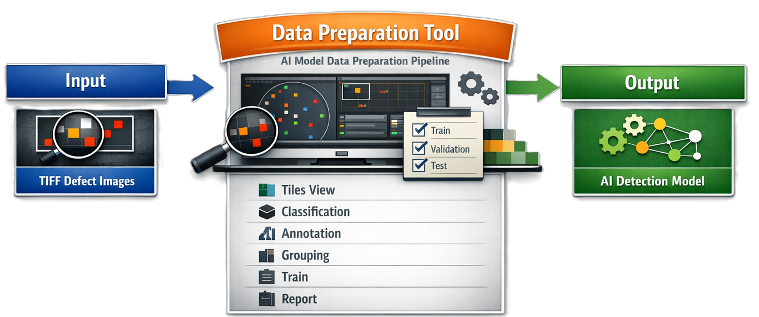
Data Preparation Pipeline

Slide 5
Flow 1 – From Scan Result to Exact Tile, Ready to Annotate
This flow is based on “From First Annotation to model report” + “Load\Prepare\Save Data Base” + “Development – Annotation tool”.
Step 1 – Load new scan data into DB
User has a freshly scanned wafer; system has saved defects only in tiff format.
In the workspace, user clicks “Load data from SR folder” / Load data.
User selects a folder that must contain tiff images. If the folder is valid, images are loaded as tiles into the DB.
Optionally, the user activates “Use detection annotation” to auto‑propose defect boxes before manual refinement.
Step 2 – Navigate to the exact tile
In the workspace, user uses one of the navigation mechanisms:
Tiles list / Frames list / Dice list in the left nav (reflecting “Tiles Gallery view”, “Frame View”, “Die View” and “Jump tiles\frames\dice”).
Or the “Jump tiles\frames\dice – enter number to jump” input, typing a tile/frame/die ID and pressing Go.
The selected tile is highlighted in the tiles grid (“Tiles\frames visual window”), and the main canvas shows that tile’s image.
Button – “show frame”. User can toggle between tile and frame ziew.

Slide 6
Flow 2 – Annotate Defects on a Tile & Manage Boxes
This flow uses “Annotation capabilities – add\remove\change defect box” and the development requirements.
Step 1 – Add and edit boxes
In the main canvas, user selects a drawing tool and adds defect boxes on the tile image:
Draw rectangle → new box appears.
Change box shape by dragging edges/corners.
Remove a box by selecting and deleting it.
User can select several boxes at once (multi‑selection) to:
Bulk delete (aligned with “Delete all annotations in tile, support selection of serval boxes”).
If they need to reset the tile- Use the global “Delete all annotations in tile” action from the toolbar, clearing all boxes for that tile.
Step 2 – Assign defect classes (multi‑class support)
In the right “Defect Classes” panel, user sees classes like Good, Surface, Via (BINs from your wafer/die/frame slides).
User selects 1 or more boxes and clicks a class (e.g., Surface):
The boxes’ outline/color changes accordingly.
The table row for that box is updated with the class.
Multiple boxes per tile each with its own class, or The tile to be tagged with multiple class records in the table.
Step 3 – Color image toggling
User can toggle “Defect color image – B&W vs Color”:
When the Color images toggle is ON, only tiles meeting the “grab define percent of defects – use only them for classification” rule show as color, others may appear in B&W or be excluded from classification view.
Step 4 – Save changes
After annotating, user clicks “Save DB” / “Save data” to persist updated defect boxes and class labels.
Temp Auto save during work. If application closed unexpectedly user can return to last state.

Slide 7
Flow 3 – Use Coordinates & Table to Validate Annotations
This flow is about the defects table and navigation based on coordinates.
Step 1 – Inspect defect data in table
After annotating, each defect box is represented as a row in the table with columns:
col, row, area, width, bbox, die coordinates, wafer coordinates.
User sorts and filters in the table:
Sort by col or row to cluster defects along wafer columns/rows.
Filter by area or width to find very small/large defects.
Filter by die coordinates / wafer coordinates to focus on specific regions.
Step 2 – Navigate via table
Clicking a row could re‑focus the canvas:
The canvas jumps to the tile containing that defect.
The corresponding box is highlighted (consistent with “show tile position in wafer map + die view” and coordinate levels).

Slide 8
Flow 4 – Allocate Tiles to Train / Validation / Test
This flow is drawn from “Allocate data to train \ validation \ test”, “Manually Insert percent of tiles for test”, and “Load the classified tiles as train\validation groups + random 10% of tiles as test group”.
Step 1 – Assign sets per tile
For the current tile, user chooses dataset membership in a small control bound to that tile, e.g., a dropdown or toggle linked to the row in the table.
Options: Train, Validation, Test.
Step 2 – Use global test percentage
In the Annotation / allocation panel, user sets “percent of tiles for test”:
Enters a number in “Manually Insert percent of tiles for test”.
When applied, the system uses this to:
Automatically mark approximately that % of eligible tiles as Test, alongside the explicit random 10% option in the model flow (“random 10% of tiles as test group”).
Step 3 – Save allocation
User clicks Save DB to store the updated train/validation/test statuses with the DB.

Slide 9
Flow 5 – Visual Navigation: Wafer → Die → Frame → Tile
This flow is directly driven by “Train data visualization”, “Wafer View”, “Die View”, and “Frame View”.
Step 1 – Wafer level
User opens the Wafer view: Sees wafer map with col\row positions of defects for train.
Defects are shown by BIN (Good/Surface/Via).
User can zoom in/out on the wafer as needed.
User clicks a specific die on the wafer:
“Press on die will open die view with defect position.”
Step 2 – Die level
In the Die view: User sees die layout “as in die edit” with defect markers for train.
User clicks a marker on the die:
“Press on marker will show the tile, and the frame, beneath the plot.”
Step 3 – Frame level
In the Frame view: Frame is divided into tiles with defect positions for train.
A Color/Bin legend (Good / Surface / Via) is visible.
User clicks tile marker:
“Press on tiles’ marker will show the tile, and the frame, beneath the plot.”
The Annotation Workspace now shows that tile with all its boxes preserved (“Move from tile to frame view, keep defect box”).
Step 4 – Jumping & filtering
At any level, user can:
Jump tiles\frames\dice – enter number to jump in a jump control.
Support sort +filter by col\row to quickly navigate across dense regions.
Configure and apply “Exclude defects at tiles edge” to filter out boxes near tile borders.

Slide 10
Flow 6 – Close the Loop: From Annotation to Model & Back
This flow ties the Annotation Workspace with the training loop described in “From First Annotation to model report” and “Development – Annotation tool”.
Step 1 – Initial training
After initial annotation and allocation, user:
“Load the classified tiles as train\validation groups + random 10% of tiles as test group.”
User runs Train model (outside or from within this tool depending on integration).
Step 2 – Review model results
If this tool replaces the report, the user opens the report / evaluation section:
Sees confusion matrix + score per defect as required.
Model folder contains train\val tiles as “model database”.
Step 3 – Iterate with additional annotations
From misclassified or low‑score regions, user navigates back into the Annotation Workspace:
Identifies tiles with errors (e.g., via coordinates or class mismatch).
Uses annotation flow again to “Classify additional defects” or refine boxes.
User then Retrains the model (“Classify additional defects – Retrain”).
After retrain, user can Scan wafer again and Report – classify and retrain if needed, repeating this cycle.

Slide 11
Flow 7 – Post Model Rule
This flow is about adding rules to AI model
Step 1 – select model and add rules
In the workspace, user clicks “Models catalog” tab.
Table list of all existing models: model name, is restricted (yes\no), job\setup\recipe, rule (yes\no), creation date, link to train report, link to model folder, confidence threshold.
User selects a model.
add rules based on BIN in the model.
Rules saved and will be part of the model.

Slide 12
Flow 8 – Inference: Offline scan with AI model
This flow is about Run a trained model on new, unlabeled data and measure real-world accuracy via user verification.
Step 1 – select model
User selects a model from Models Catalog
Model already includes:
Architecture
Weights
Post-model rules (BIN overrides, thresholds)
Step 2 – Load new dataset
In the workspace, user clicks “Select data”.
Dataset:
Was not used for training
Has no ground truth labels
Step 3 – Run inference
User click “Scan”
System produce predictions only
Defect locations
Defects classes
Confidence scores

Slide 13
Flow 8 – Inference: Offline scan with AI model
This flow is about Run a trained model on new, unlabeled data and measure real-world accuracy via user verification.
Step 4 – Human Verification
User reviews predictions and responds to them:
Agree
Disagree
In the workspace, user clicks “Calculate Accuracy”.
System computes metrics based on:
Model prediction
User agreement/disagreement

Slide 14
Flow 9 –Model Comparison & Deployment Decision
This flow is about result-level analytics.
Compare inference results from two models or algorithms on the same dataset
Define one result set as Baseline and another as Candidate
Match defects by spatial proximity using a configurable search radius
Visualize agreement and differences across wafer, die, and frame levels
Review accuracy metrics and defect‑level consistency
Select the best performing model for production deployment

Slide 15
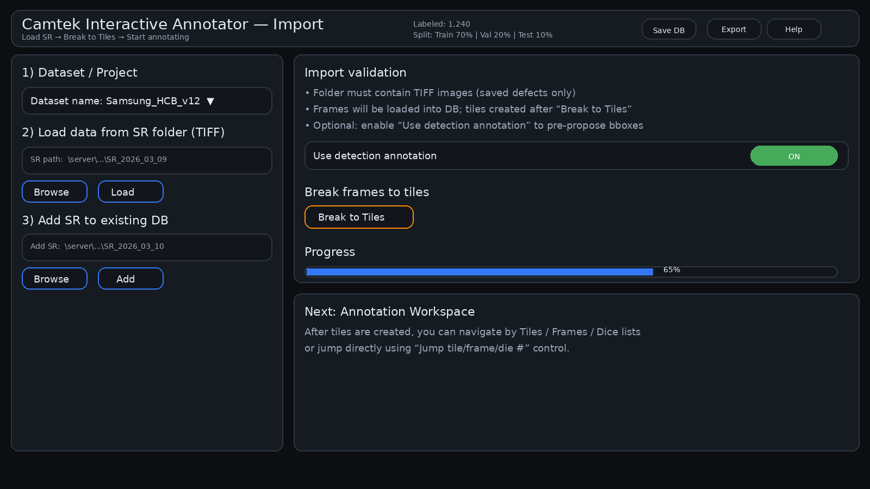

Slide 16
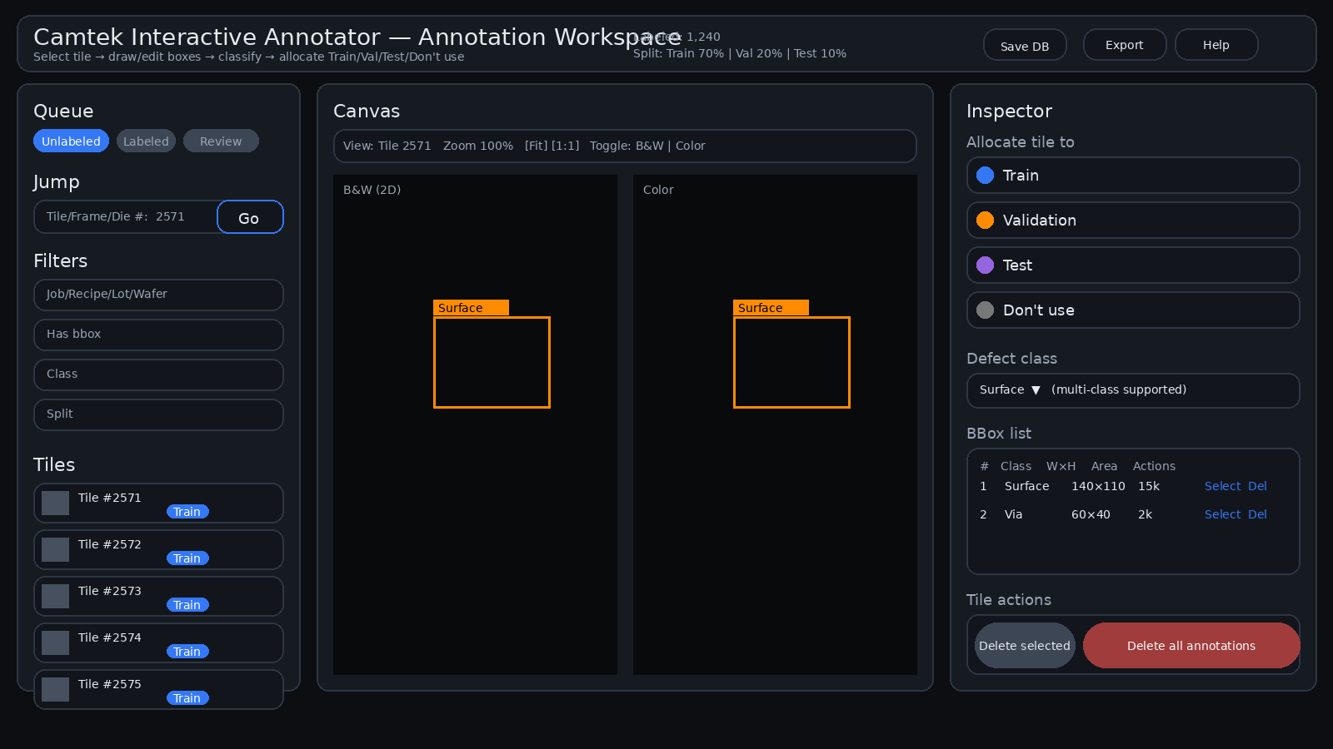
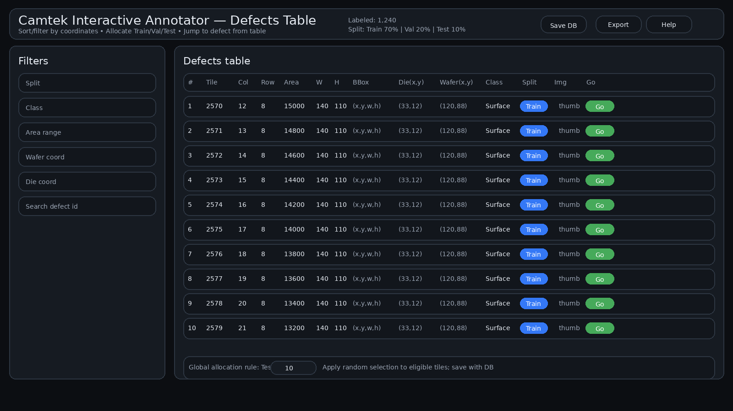
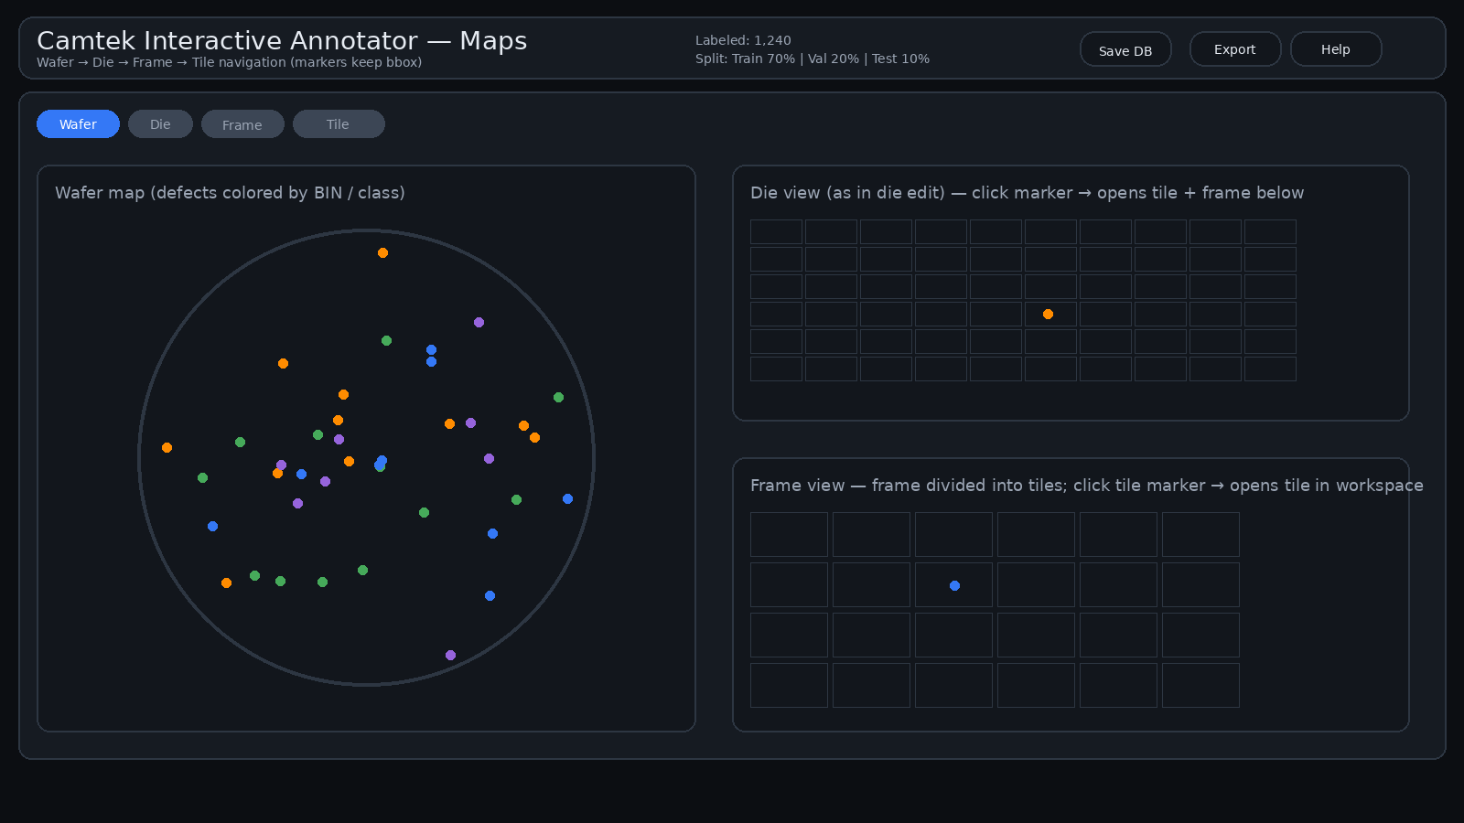
Train

Slide 17
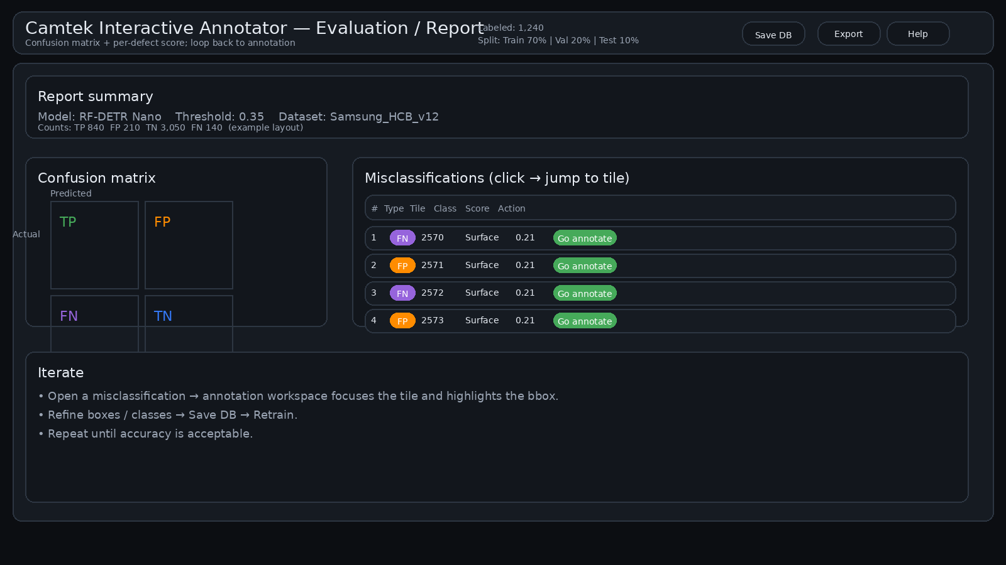

Slide 18
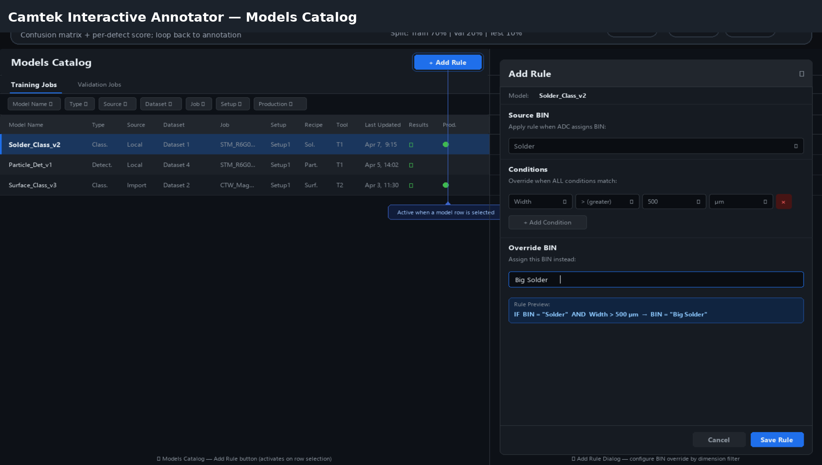

Slide 22
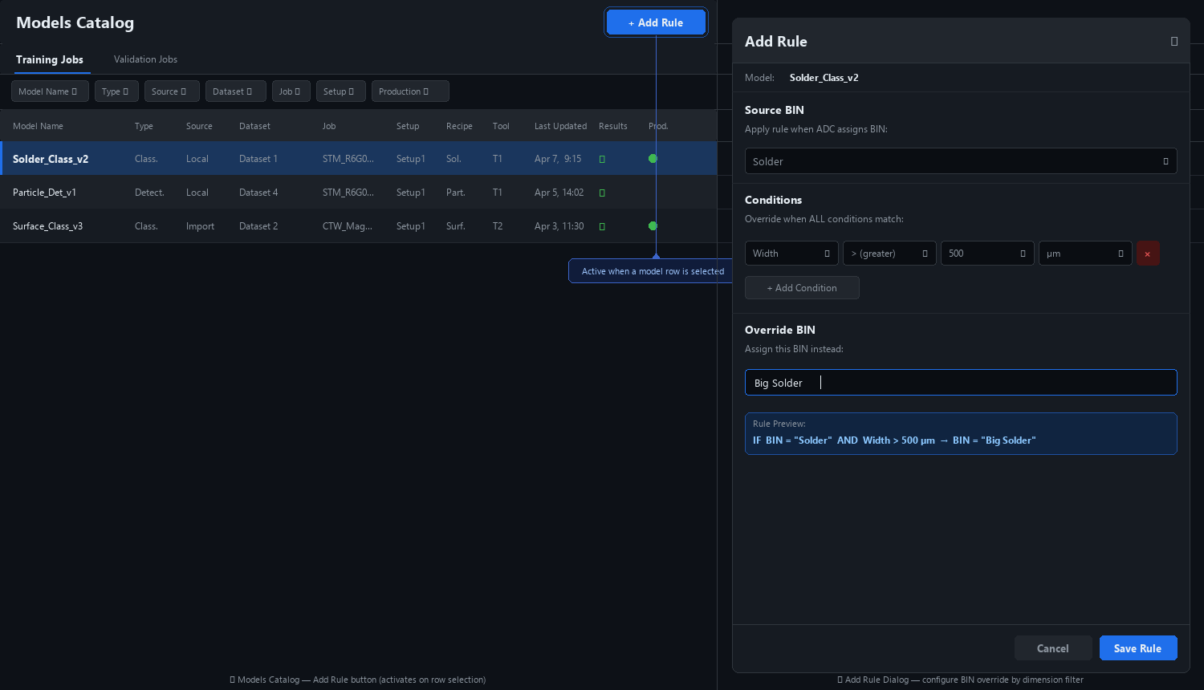

Slide 24
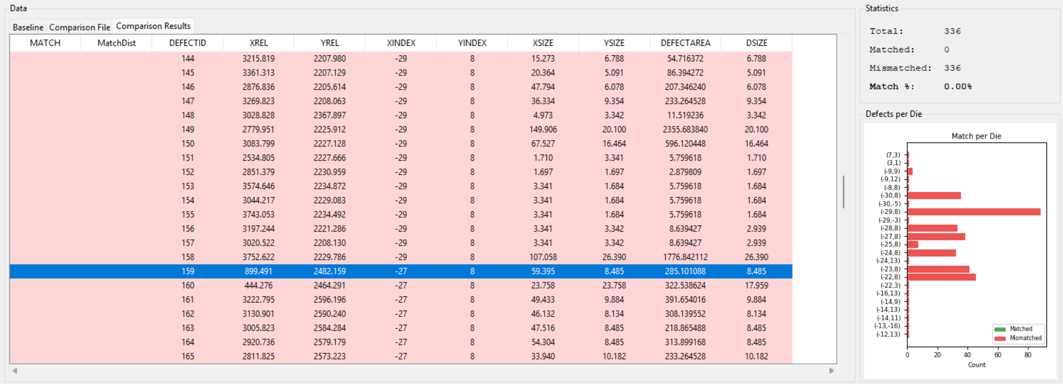
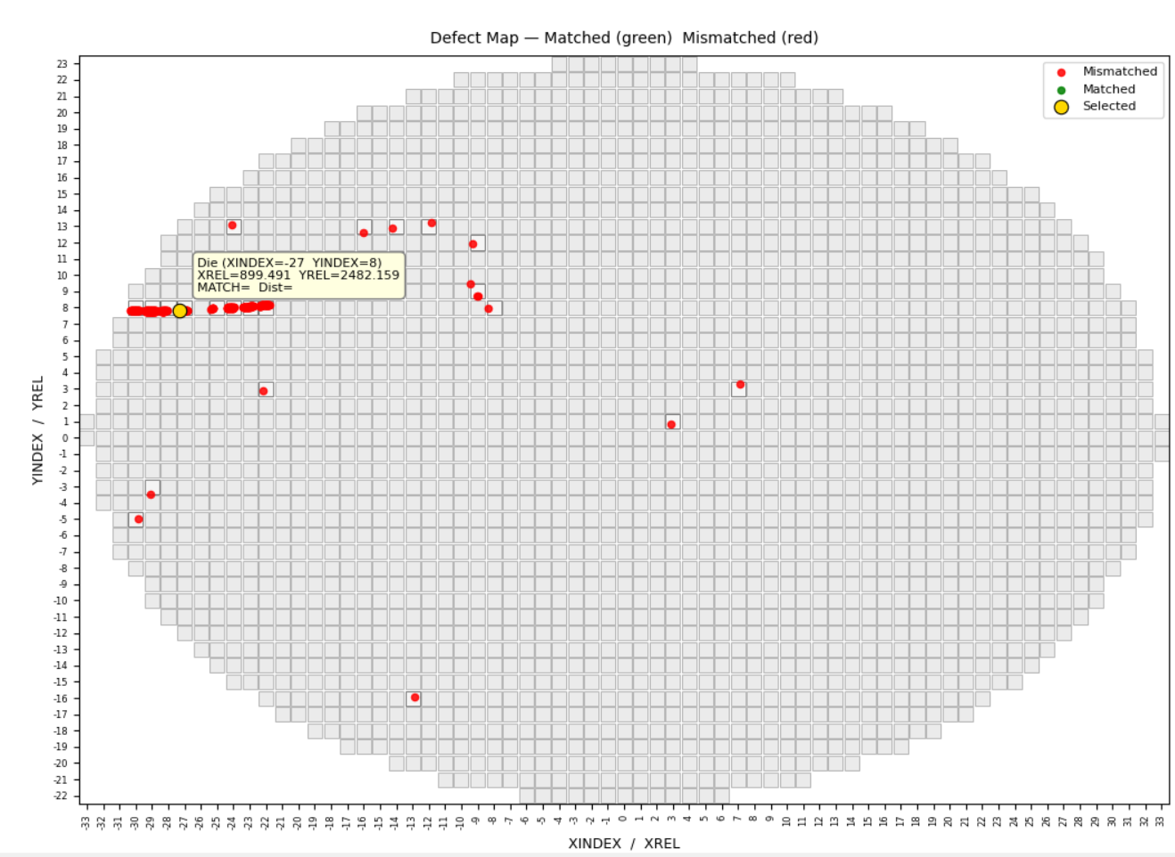



Wafer\Die View
Wafer plot will show all the dice in the wafer. Different colors to scan\unscanned dice.
Defects colors by classification
Table and wafer\die view are connected
When selecting row in the table the defect is highlighted in the plot and vice versa.
When hovering over a defect show tool tip with defect data – col\row\data\id

